Slide 1
An Online Database System for Money Management
Matthew Wiberg, john wang (presenter)
Department of Computer science
Virginia Wesleyan university

Slide 2
project Goal
Inspiration
Application
Website
Many people develop bad habits with money
Can use website to keep track of monthly flow of money and learn budgeting
Use various knowledge from classes
combine HTML, CSS, PHP and Mysqli
Design secure profile login system
use database to store financial information
Retrieval/Display Financial information to user

Slide 3
Software/Languages
SSH Secure Shell Client – securely connect to zeus server and update website
Textpad – kept backups of files written on SSH to the server as Text files
HTML, CSS, PHP and Mysqli

Slide 4
Methods/Design
Forms/Scripts
Mysqli
Profiles
use html to create forms for user input
Use php to create the action script pages to make website function
1) all information input by users stored in database (mdwiberg) tables on zeus server
website allows for creation of profiles to view your own specific information
uses database and linking of tables to allow this to happen

Slide 5
Flow chart
CS489index
CS489ProfileHomepage
CS489footer
CS489header
CS489uAccount
CS489vAccount
CS489uAccount2
CS489uAccount3
CS489vAccount2

Slide 6
CS489header
CS489footer
aboutMM
CS489index
CS489Login
home
CS489NewUser
CS489Login
CS489NewUser2
CS489Login2

Slide 7
dbHander
CS489NewUser2
CS489Login2
CS489uAccount2
CS489uAccount3
CS489vAccount2
Project URL: https://zeus.vwu.edu/~mdwiberg/CS489index.php

Slide 8
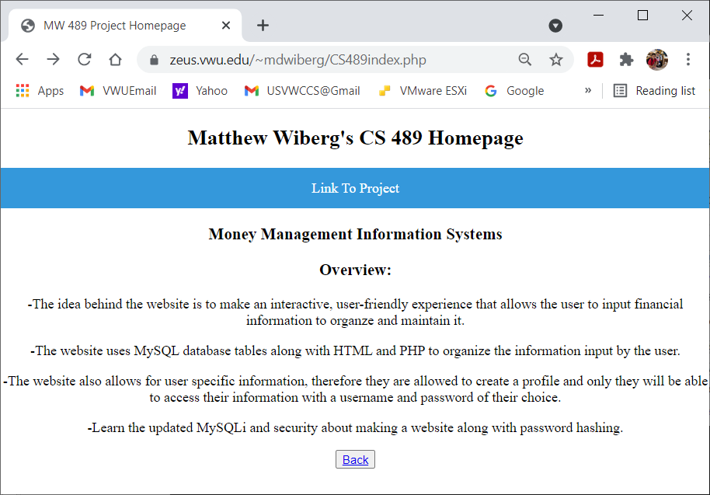
Project Website

Slide 9
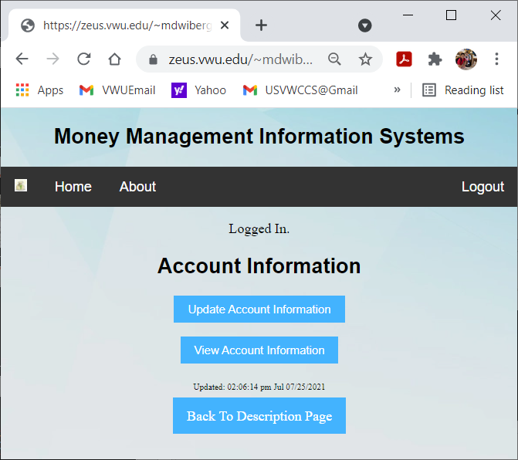
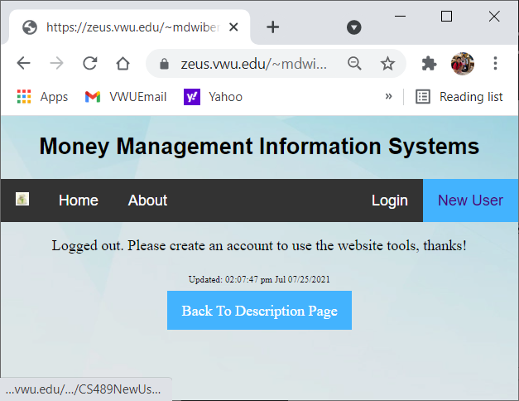
Profile creation/login

Slide 10
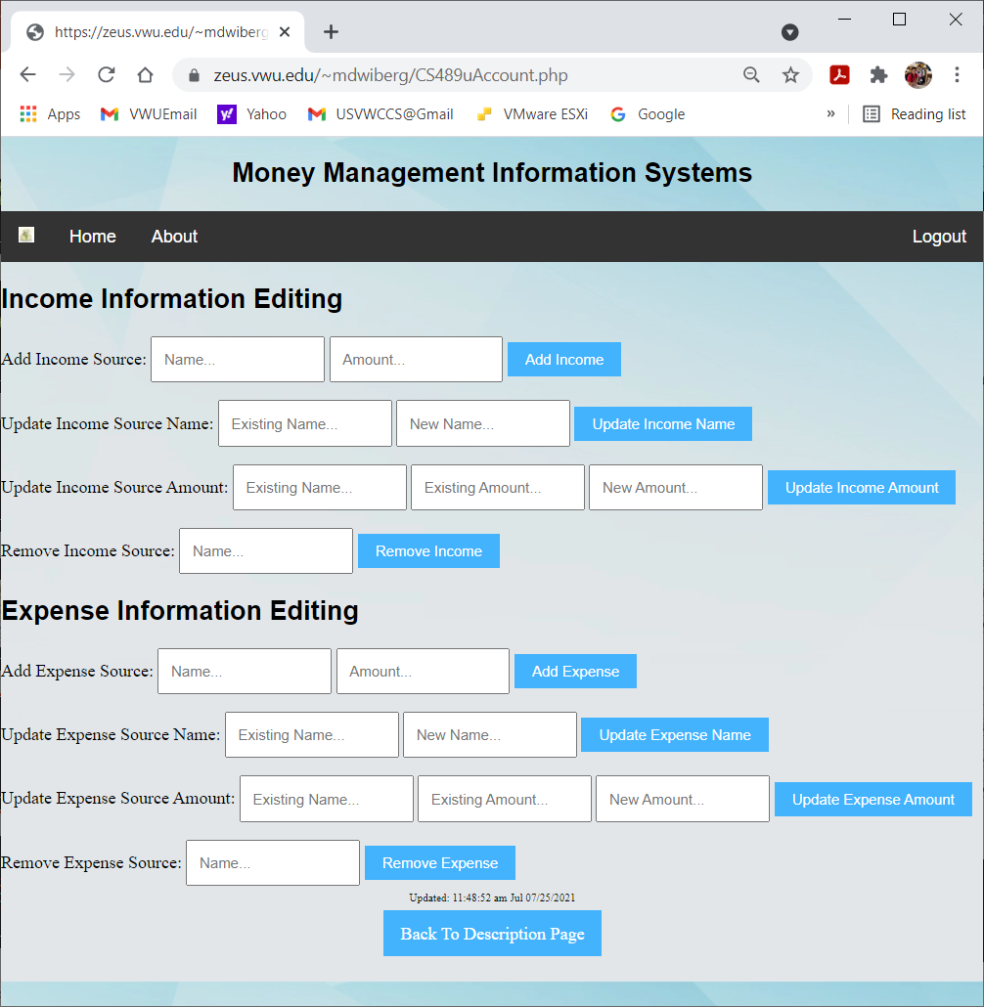

Slide 11
Further ideas
Add option for users to view income and expenses tables
Display income and expense totals
Display total monthly financial flow
Add CSS for aesthetics
Add a checkbook like system to view all past transactions

