Slide 1
An Online Interactive Database Platform For Career Searching
Dr. John Wang
Professor of Computer Science
Virginia Wesleyan University
Virginia Beach, VA 23455, USA

Slide 2
Content
Introduction
System outline
Case study
Conclusion

Slide 3
Introduction
College seniors, new graduates
Job search
Tools?
A specific platform for communications
Online database with security and functionality

Slide 4
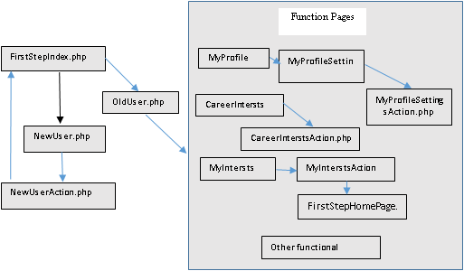
System Outline (1)

Slide 5
System Outline (2)
When visiting the site, the user’s log info will first be sent to FirstStepIndex.php
Have the option to register an account or to log in.
Have multiple options:
visiting their profile information
selecting career interests
requesting partners as friends
Available on a sidebar so the user to view all of their at the same time.

Slide 6
System Outline (3)
Registration tables: log and personal info
Password secured with MD5 function

Slide 7
System Outline (4)
Partner table: show if two are partners
Status: a partner request (0); accepted a request (1); rejected a request (2); partners (3)

Slide 8
System Outline (5)
Interests table:

Slide 9
System Outline (6)
Comments table:
if a user posts a comment - their username will be stored along with the comment to be viewed for others who are also interested in this career

Slide 10
Case Study (1)
Login page

Slide 11
Case Study (2)
Registration page

Slide 12
Case Study (3)
Registration action script

Slide 13
Case Study (4)

Slide 14
Case Study (5)

Slide 15
Case Study
The system site
http://zeus.vwu.edu/~bdstamour/ResearchIndex.php
(online show)

Slide 16
Conclusion
The system with career interests and dynamic comment pages
Along with the partners and interests with functionality and security.
Implemented with PHP and MySQL

